Slide 1
19CS82C - Internship/Inplant Training Internshala - Web development
By
A PRASANNA KUMAR
1912019
4th year CSE

Slide 2
About Internshala:
Internshala provides inplant trainings, internships, freshers jobs and job-oriented specializations.
In training, they provides different domains like data science, web development, ethical hacking, programming, cloud computing, android app development, machine learning, so on.
I have done web development domain and it consists of different sections as an online course with allotted projects in each section.

Slide 3
Web Development:
Web development, also known as website development, refers to the tasks associated with creating, building, and maintaining websites and web applications that run online on a browser.
It may, however, also include web design, web programming, and database management.
Web development is closely related to the job of designing the features and functionality of apps (web design).
The term development is usually reserved for the actual construction of these things (that is to say, the programming of sites).

Slide 4
Hyper Text Markup Language:
Basic Concepts of Web Development
Setting Up Local Environment
Introduction to HTML
HTML Tags
Lists, Tables, and Forms

Slide 5
Cascading Style Sheets:
Introduction to CSS
CSS Selectors
Unit: Length and Colour
CSS Properties
Box Model
Inspect Element
Display
Position
Structuring a Web Page
Flexbox
Media Queries

Slide 6
Bootstrap:
Introduction to Bootstrap
Layout
Other components

Slide 7
Data Base Management System:
Introduction to DBMS
Basic Concepts and Terminologies
SQL Queries - Database Related
SQL Queries - Tables Related
SQL Queries - Records Related
Designing a Database
Database Relationships
Join Queries
Importing and Exporting a Database

Slide 8
Hypertext Pre Processor:
PHP: Introduction and Installation
Variables and Operators
Conditional Statements
Loops
Arrays
Strings
Functions
Form Submission
Database Communication
Cookies and Sessions

Slide 9
Java Script:
Introduction to JavaScript
Variables and Operators
Conditional Statements and Loops
Functions
Objects and Classes
Arrays
Strings
JavaScript as a Client Side Language
Debugging JS Using Inspect Element
AJAX

Slide 10
React:
Introduction to React
Creating an Element
JSX
Components
Props
States
Managing States and Data Flow
Create React App
Breaking Into Modules
Deploy

Slide 11
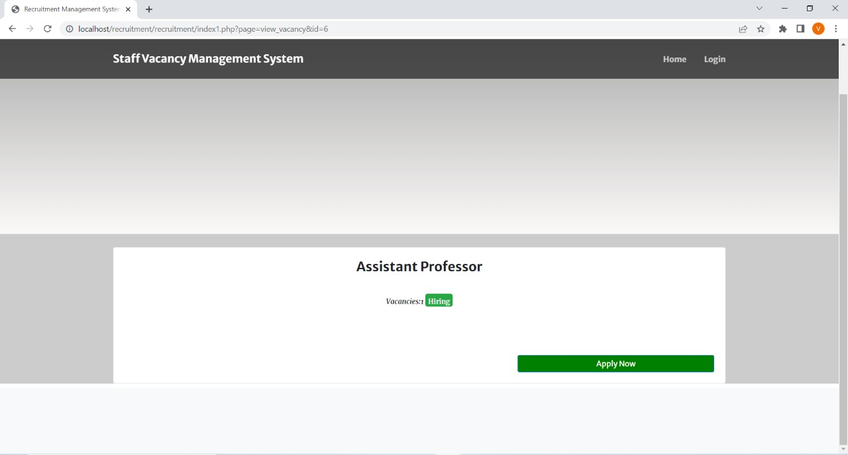
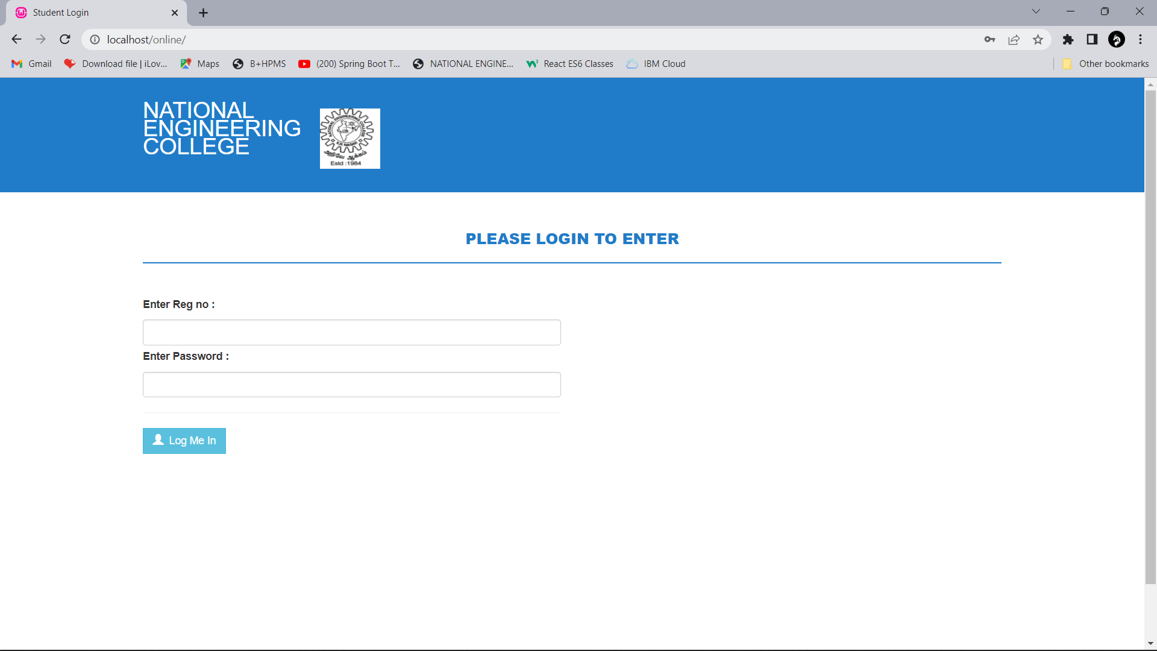
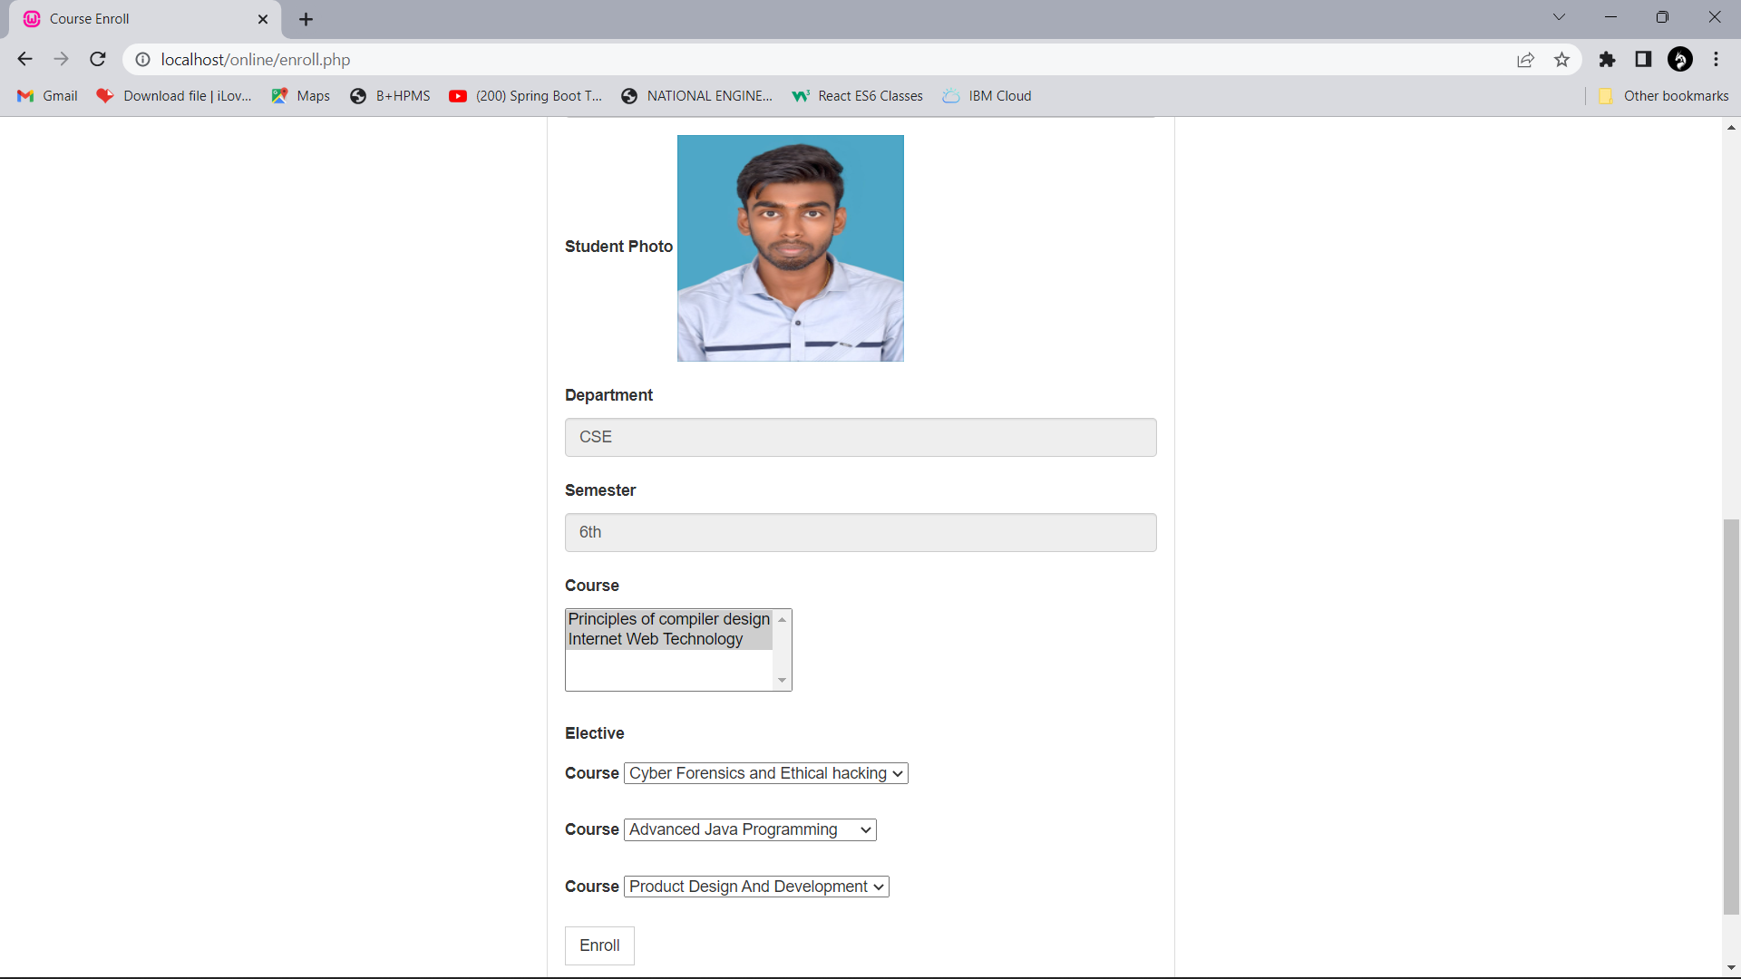
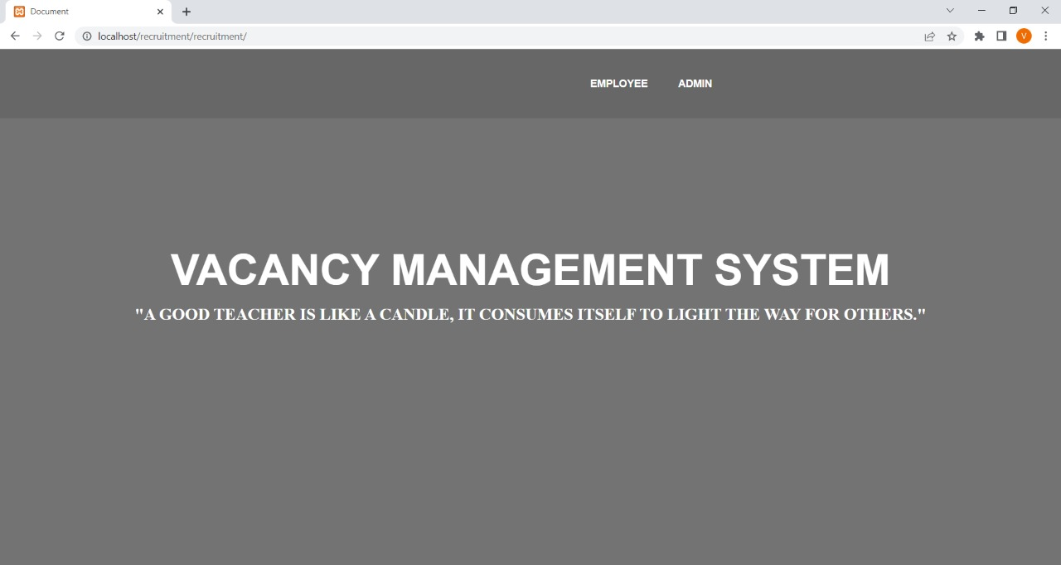
Final Project Work
Student side
Home page

Slide 12
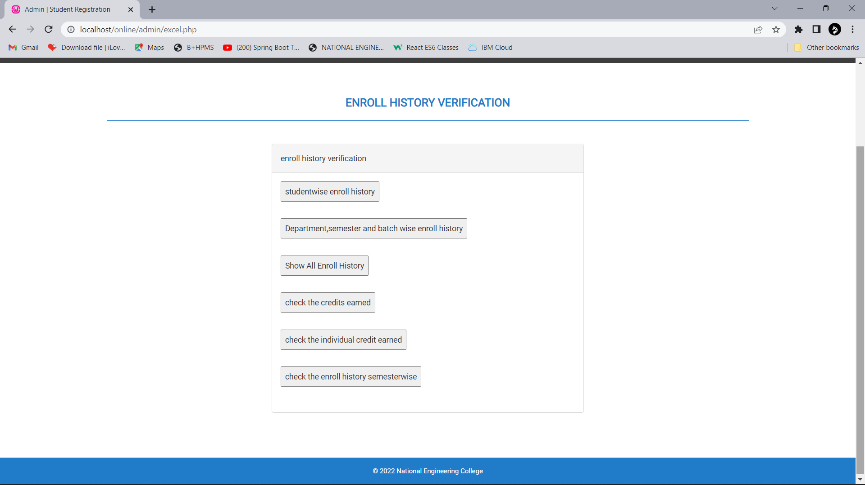
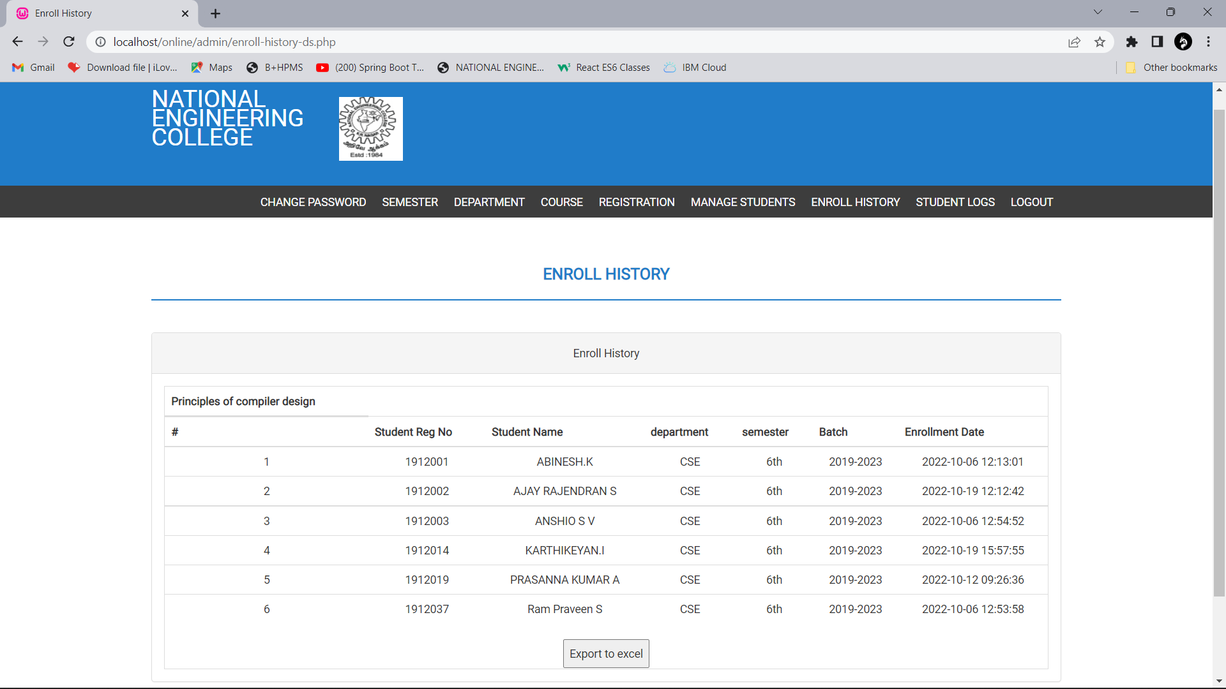
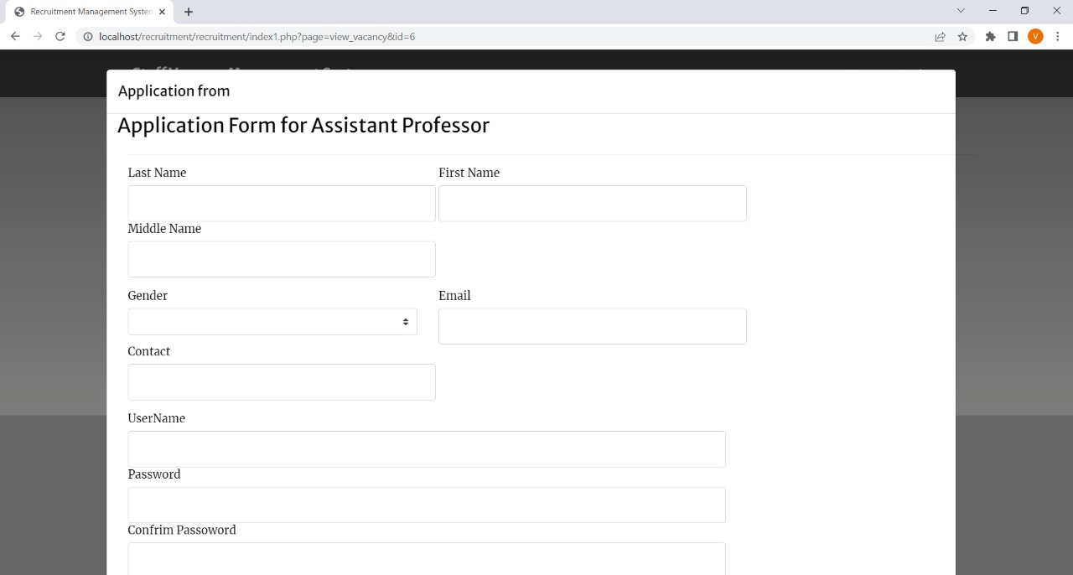
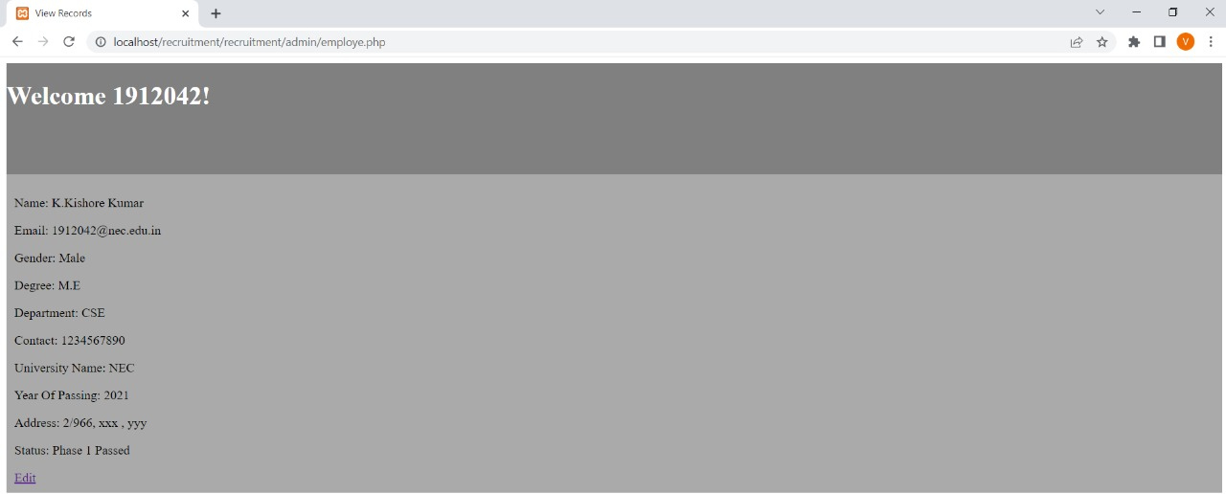
Final Project Work
Admin Menu
Sub-code wise check

Slide 13
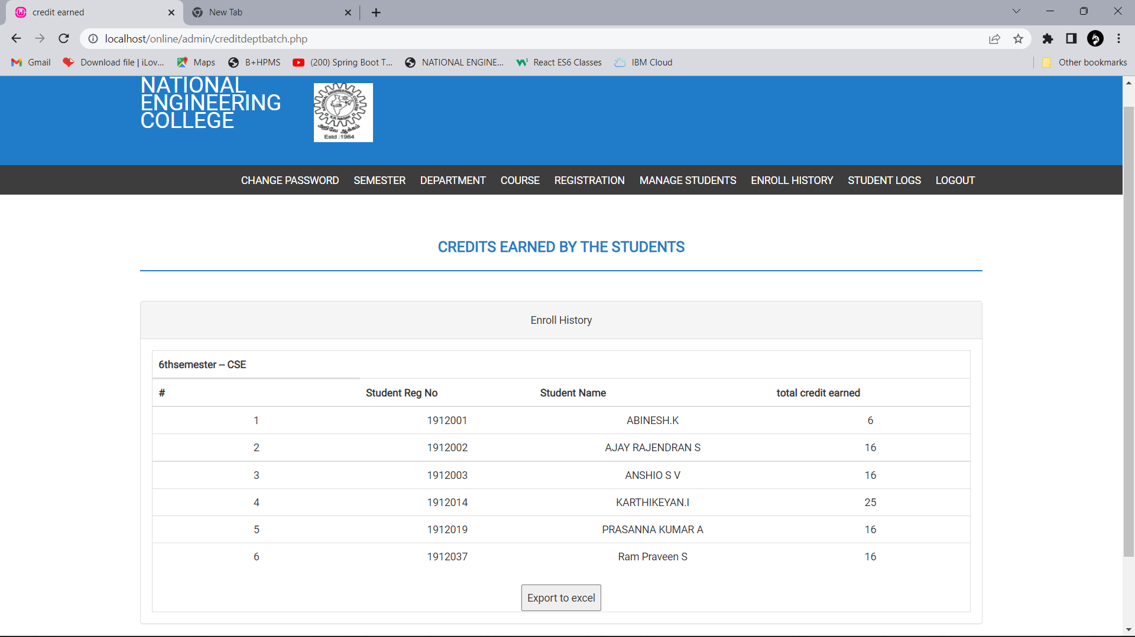
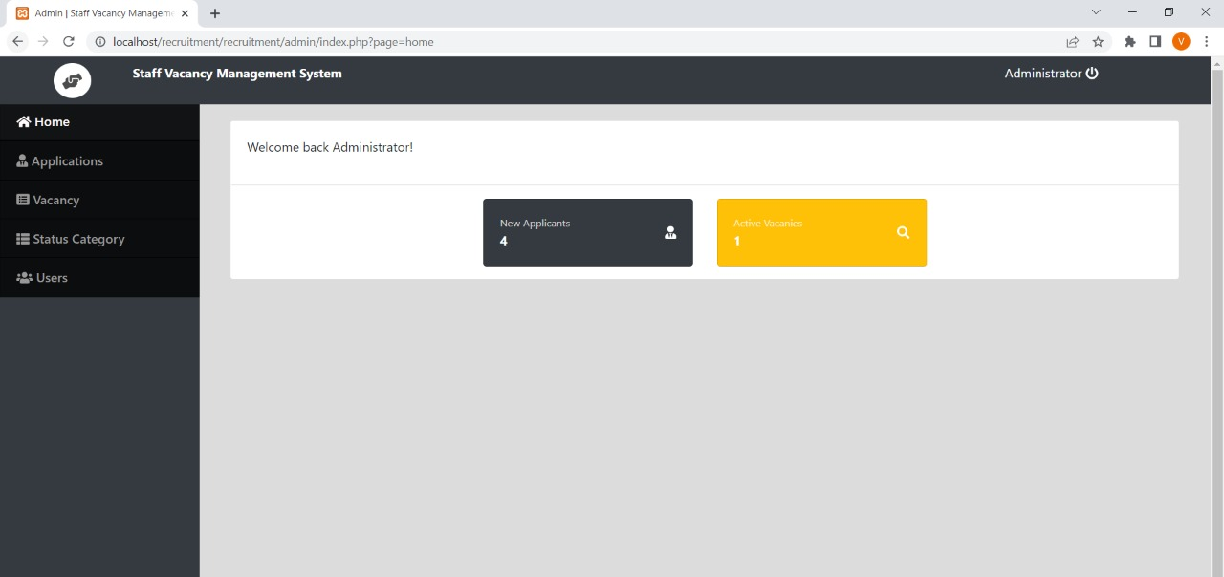
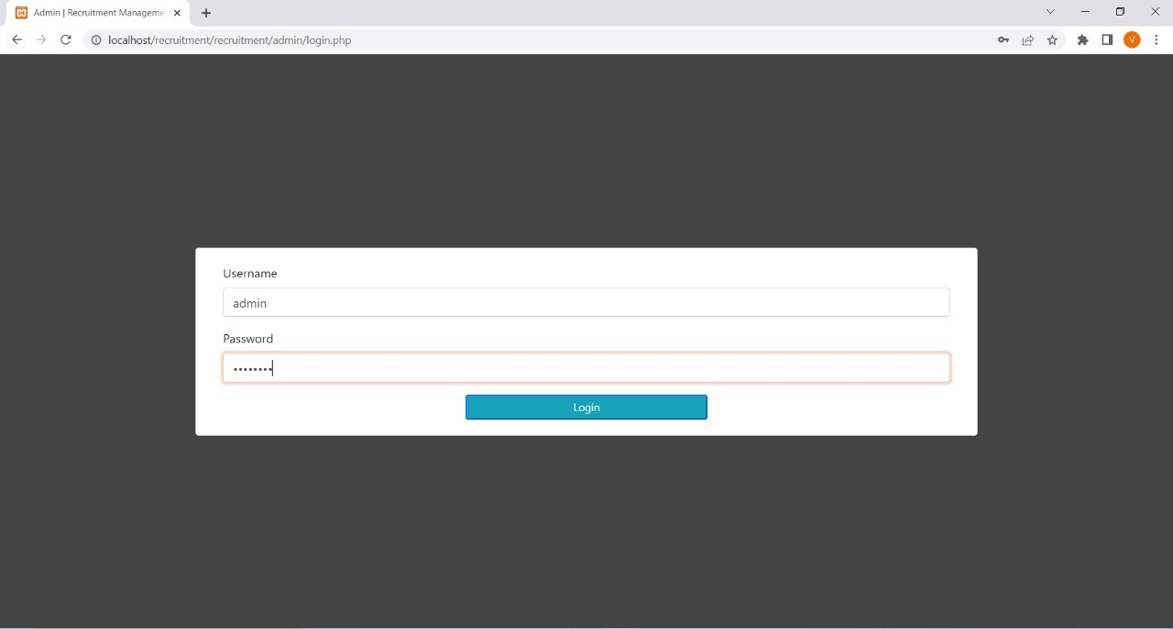
Final Project Work
Admin Enroll History Check
Admin Credit Check

Slide 14
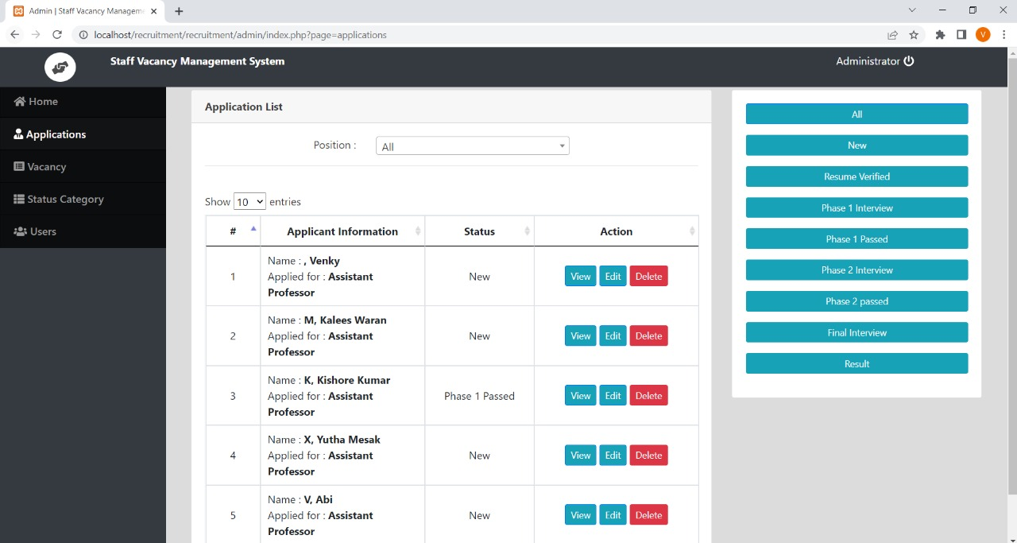
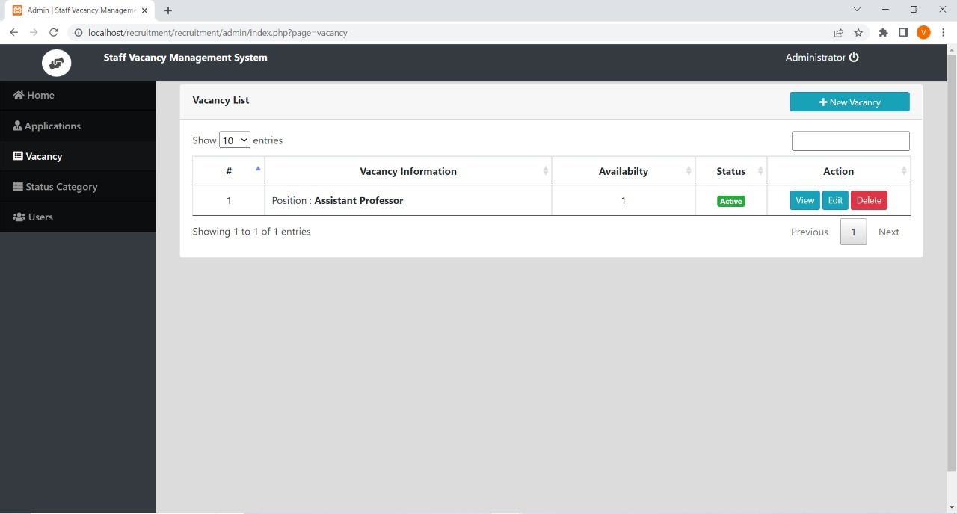
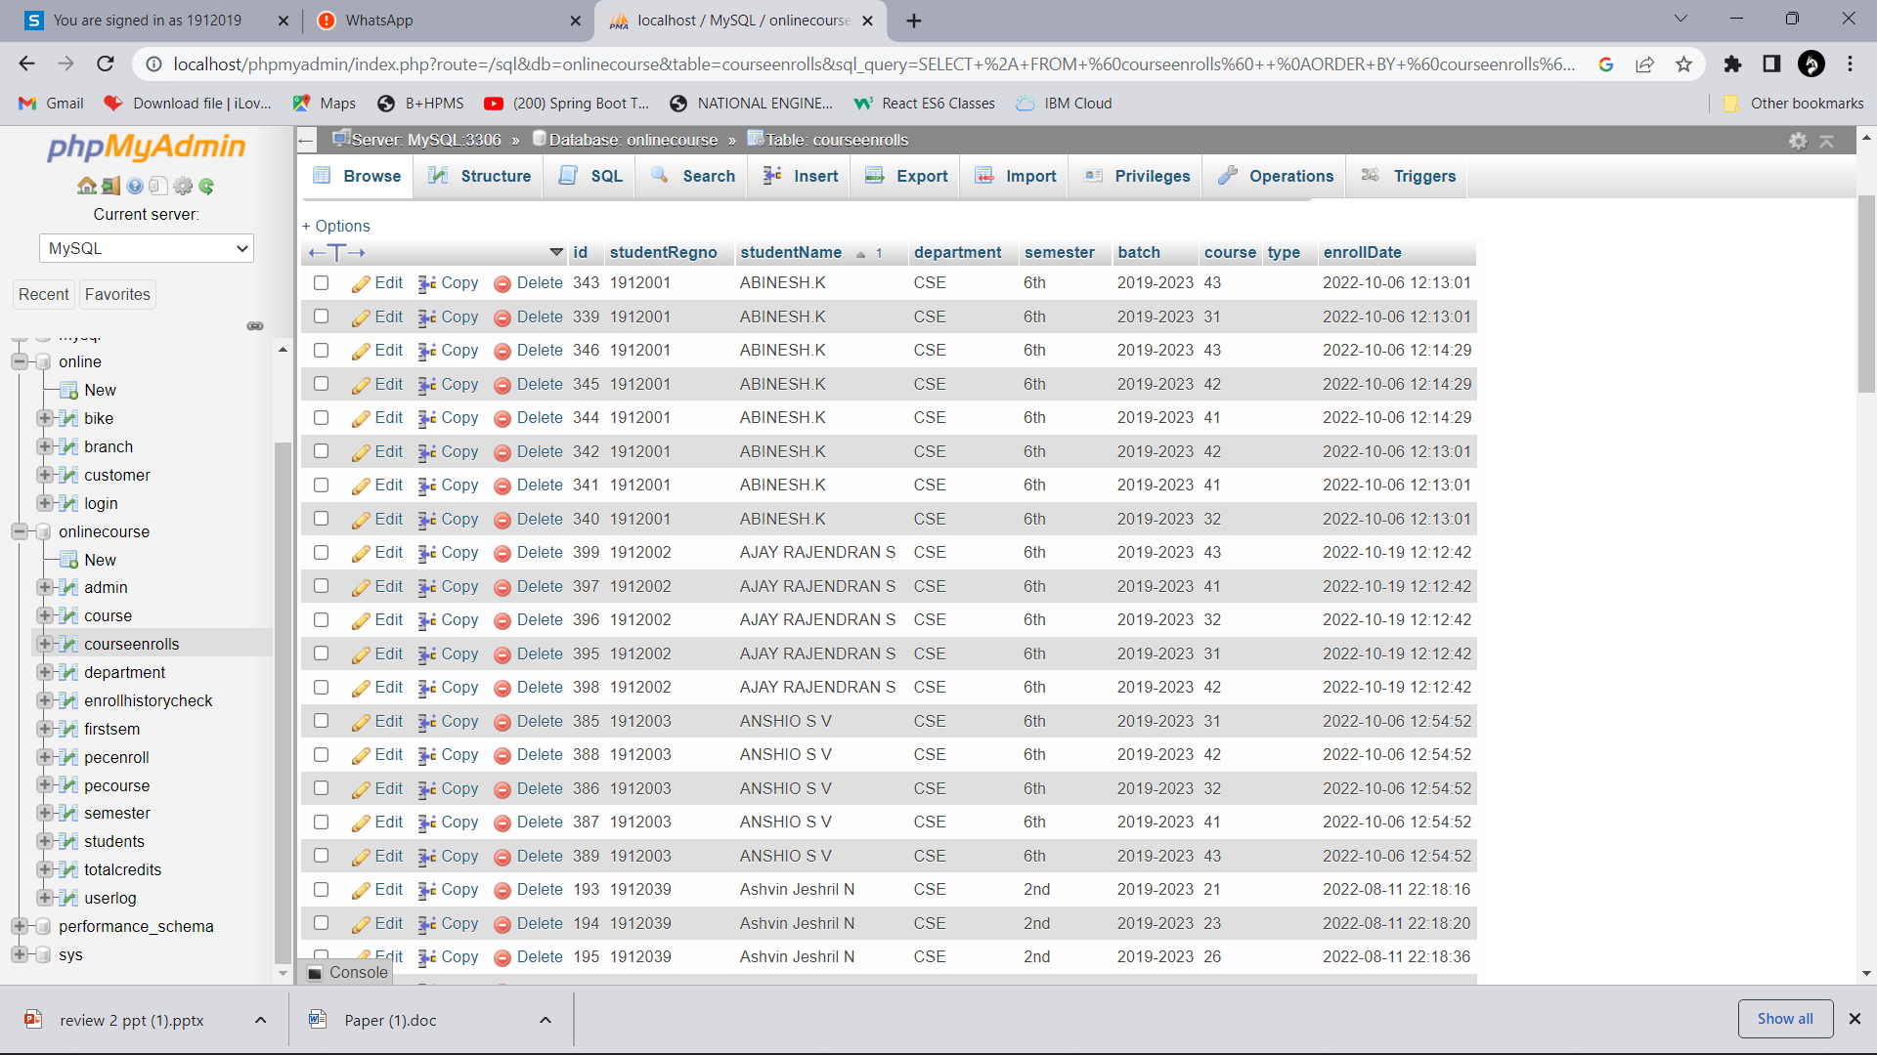
Final Project Work
Database of the application

Slide 15
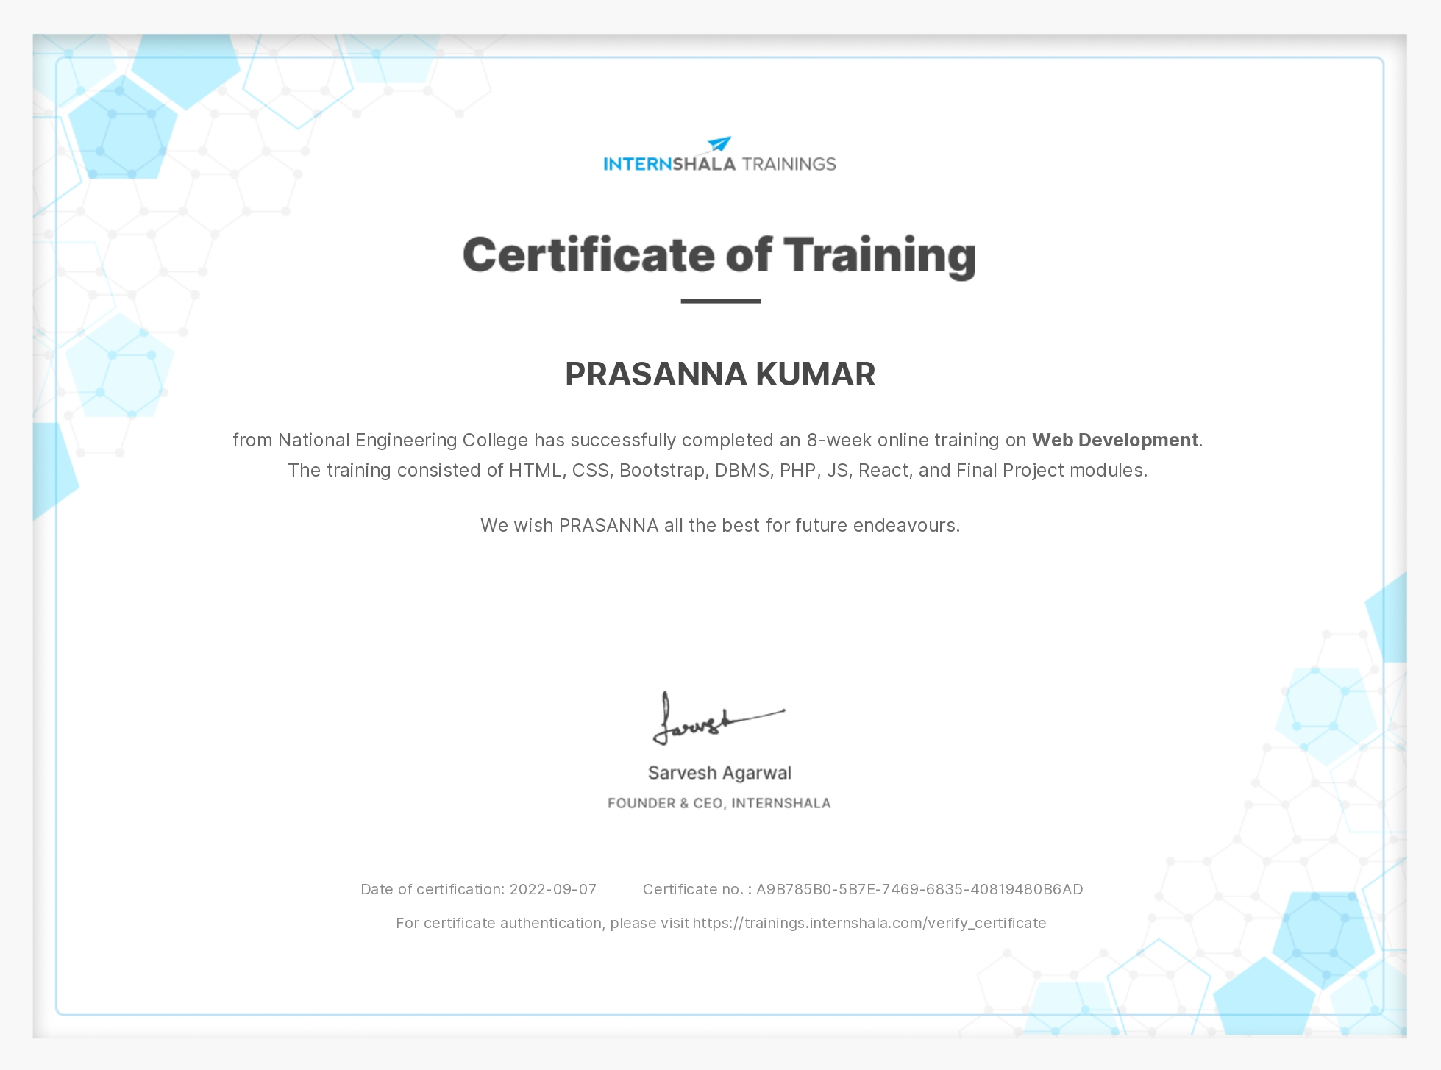
Certificate:

Slide 16
Conclusion:
The web is probably not going away in our lifetime. A career as a web developer will offer us stability and long-term visibility. As the internet becomes a larger community every day, the job market is expanding, creating new opportunities for developers.
Since e-commerce is taking over the world, clients across all sectors are looking for web developers. The demand for web developers in the last decade has been sky-high with lucrative compensation. Jobs for web developers are expected to increase up to 20 percent from 2012-2022.
As a web developer, we get to conceptualize and create websites from start to finish. It is common knowledge that developers are incredible artists. We get to create something tangible that will have an impact on our users.

Slide 17
THANK YOU

